Slide 1
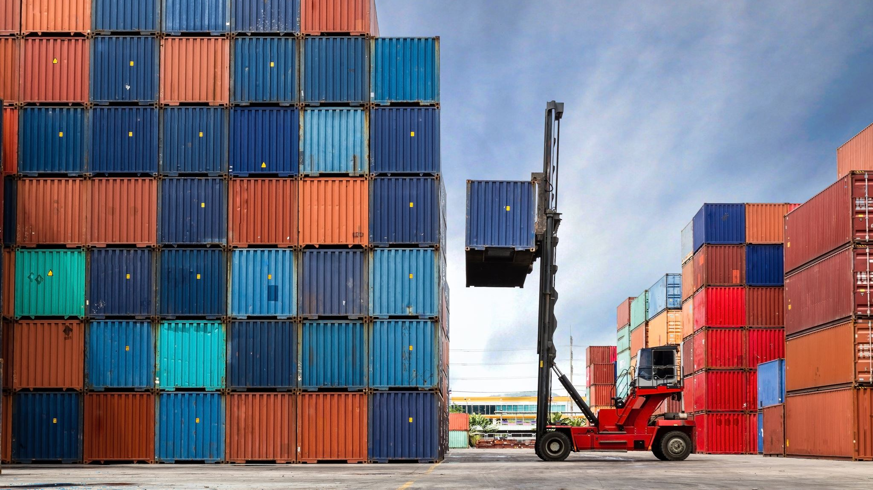
Session 5: E-Commerce Logistics and Operations

Slide 2
Comparative Summary (Exam-Friendly)
Company | Key Strength
Amazon | Speed, automation, predictive analytics
Alibaba | Platform ecosystem & data integration
Flipkart | India-specific logistics expertise
JD.com | Full logistics ownership & control
Walmart | Scale & omnichannel efficiency
Zomato | Ultra-fast last-mile execution

Slide 3
Introduction to E-Commerce Logistics
Definition:
E-commerce logistics refers to the process of managing the movement of goods from a seller to a buyer, including warehousing, order fulfillment, shipping, and delivery.
Importance:
  Customer satisfaction depends on efficient logistics.
  Competitive advantage: Fast, cost-effective delivery is key.
  Enables scalability for global reach.
E-Commerce Growth:
  Growth in online sales, especially during the pandemic.
  The rise of omni-channel retailing.

Slide 4
Order Management and Fulfillment Process
Order Management:
  Definition: The process of receiving, processing, and tracking customer orders.
  Key Functions:
    Order entry (via website, app, etc.)
    Order processing (payment verification, inventory check)
    Order tracking (real-time updates for customers)
    Returns management (handling returns and exchanges)
Fulfillment Process:
  Definition: The complete process from receiving an order to delivering it to the customer.
  Steps Involved:
    Picking: Selecting the products from inventory.
    Packing: Ensuring items are securely packed for transport.
    Shipping: Dispatching the order for delivery.
Automation & Technology:
  Use of Warehouse Management Systems (WMS).
  Integration of Enterprise Resource Planning (ERP) systems for seamless order flow.

Slide 5
E-commerce Order Management
End-to-end process of order capture, inventory allocation, fulfilment, last-mile delivery, and returns
Focus on speed, accuracy, real-time tracking, and customer experience
Key challenges: demand forecasting, reverse logistics, peak-sale scalability
Example:
Amazon : highly automated warehouses, AI-driven inventory placement, same-day delivery models

Slide 6
Shipping and Delivery Options in E-Commerce
Shipping Options:
  Standard Shipping: Cost-effective, but slower delivery.
  Expedited Shipping: Faster delivery, higher cost.
  Same-Day or Next-Day Delivery: Premium service for immediate needs.
  Free Shipping: A popular customer incentive but requires cost management.
Delivery Channels:
  Third-Party Logistics (3PL): Outsourced logistics providers that handle shipping and fulfillment.
  In-House Delivery: The e-commerce company manages its own shipping operations.
  Click-and-Collect: Customers pick up orders from a physical location.
  Last-Mile Delivery: Critical to customer satisfaction; efficient delivery to the customer's doorstep.
Innovative Shipping Methods:
  Drone Delivery: Emerging tech for faster and more efficient last-mile solutions.
  Smart Lockers: Self-service lockers for easier package pickup.

Slide 7
Green Logistics
Adoption of electric vehicles (EVs) for last-mile delivery
Use of micro-warehouses to reduce travel distance
Sustainable packaging & route optimization to reduce carbon footprint
Increasing importance due to ESG mandates and consumer awareness
Example:
EV delivery fleets by Amazon, urban dark stores reducing emission

Slide 8
ESG is a framework that evaluates a company’s environmental impact, social responsibility, and governance practices to assess its long-term sustainability and ethical performance.
Why ESG Matters
Impacts investment decisions and company valuation
Reduces regulatory and reputational risk
Builds long-term sustainability and trust
Increasingly linked to customer preference and talent a

Slide 9
The Role of Supply Chain Management in E-Commerce
Definition: Supply Chain Management (SCM) in e-commerce involves the management of the flow of goods and services from supplier to customer, ensuring that products are available when needed.
Key Functions of SCM in E-Commerce:
  Inventory Management: Balancing stock levels to meet demand without overstocking.
  Demand Forecasting: Predicting customer needs based on past behavior and trends.
  Supplier Coordination: Managing relationships with suppliers to ensure timely restocks.
  Logistics Coordination: Ensuring smooth flow from warehouse to customer, including transportation management.
Key SCM Technologies in E-Commerce:
  Just-In-Time (JIT) Inventory: Reduces storage costs by ordering goods only when needed.
  Cloud-Based SCM Solutions: Improves flexibility and real-time visibility.
  Blockchain in SCM: Enhances transparency and traceability of products in the supply chain.
Challenges in E-Commerce Supply Chain Management:
  Managing global suppliers.
  Navigating complex regulatory environments.
  Handling peak demand periods (e.g., holidays, sales events).

Slide 10
Challenges and Trends in E-Commerce Logistics
Challenges:
Cost Management: Shipping and logistics costs are a significant part of the e-commerce budget.
Delivery Delays: Customers expect fast delivery, and delays can impact brand reputation.
Returns Management: Handling returns efficiently without incurring high costs.
Last-Mile Delivery: Ensuring cost-effective and timely delivery to the final destination.
Trends:
Sustainability: Green logistics practices, such as electric vehicles for deliveries.
Personalized Delivery Options: Customizable delivery windows and locations.
Artificial Intelligence and Machine Learning: Optimizing routes, predicting demand, and automating warehouses.
Omni-channel Logistics: Seamless integration of online and offline channels for inventory and fulfillment.

Slide 11
Case Studies and Best Practices
Amazon:
Prime Delivery Model: Revolutionized e-commerce logistics by offering fast, free delivery and same-day or next-day options.
Warehouse Automation: Extensive use of robots and AI to speed up the fulfillment process.
Zara (Inditex):
Fast Fashion Supply Chain: Efficient inventory management and rapid replenishment of items based on customer demand.
Quick Response to Trends: Integration between e-commerce and physical stores allows for rapid adaptation to trends.
Walmart:
Click-and-Collect Strategy: Combining in-store pickup with e-commerce sales to create a hybrid shopping experience.
Expansion of Delivery Options: Introduction of free two-day shipping and partnerships with third-party carriers.

Slide 12
Key Differences Between Supply Chain and Logistics:
Aspect | Supply Chain | Logistics
Scope | Broader and covers end-to-end processes from raw materials to the final customer. | Narrower, focusing mainly on the transportation, warehousing, and delivery of goods.
Functions | Includes procurement, production, inventory management, distribution, and demand forecasting. | Primarily deals with transportation, warehousing, packaging, and order fulfillment.
Goal | To optimize the overall flow of goods, information, and services to meet customer demand. | To ensure efficient movement and storage of goods in the supply chain.
Focus | Emphasizes coordination and integration of suppliers, manufacturers, and distributors. | Emphasizes the physical flow of goods and services from one point to another.
Key Activities | Supplier selection, production scheduling, demand forecasting, and customer relationship management. | Transportation management, warehouse operations, inventory management, and packaging.
Interdependence | Logistics is a key component of the supply chain, and without effective logistics, the supply chain cannot function properly. | Logistics is essential to supporting supply chain operations, but it does not manage the whole end-to-end process.

Slide 13
Conclusion and Key Takeaways
Efficiency and Customer Satisfaction: The success of e-commerce logistics is based on the ability to deliver orders efficiently, on time, and with minimal cost.
Technological Integration: Advanced technologies such as AI, machine learning, and cloud-based solutions are critical to optimizing logistics and supply chain management.
Sustainability and Flexibility: The future of e-commerce logistics lies in sustainability and flexible, personalized delivery options for customers.
The Role of Supply Chain: Effective supply chain management is essential for streamlining operations, reducing costs, and meeting customer expectations in the competitive e-commerce space.

Slide 14
What is the primary objective of supply chain management?
A) To manage financial transactions between suppliers
B) To reduce production costs without considering quality
C) To efficiently coordinate and control the flow of goods and services from raw materials to the end customer
D) To create marketing campaigns for products

Slide 15
Which of the following is NOT typically a key function of a supply chain?
A) Procurement
B) Logistics
C) Marketing
D) Inventory management

Slide 16
What is the "bullwhip effect" in supply chain management?
A) Increased demand forecasting accuracy
B) A phenomenon where small changes in consumer demand cause larger fluctuations in orders placed upstream
C) A method to reduce transportation costs
D) A process for better inventory management in the supply chain

Slide 17
Causes of the Bullwhip Effect
While the bullwhip effect starts with simple demand spikes, many elements contribute to it:
Supply chain complexity: Global supply chains are becoming more and more complex. Consumer demands are changing, orders are more varied, and detailed data is widely available. These factors and many others can create a complex but competitive supply chain. These supply chains tend to involve more parties and more touchpoints, so they have many spots for the bullwhip effect to take hold.
Consumer expectations: Meeting customer demands often involves more options, like in-store pickups and direct-from-vendor shipments. These different requirements can increase pressure to have products on-hand and cause the supply chain to branch off into more avenues. Ensuring stock for each option can contribute to overstocking.
Batched orders: Members of the supply chain might choose to round their orders up or down for simplicity or wait until a certain date to order, which isn’t necessarily an accurate reflection of demand.
Price fluctuations: Discounts, sales, and other offers affect typical demands and may lead to inaccurate forecasts as buyers attempt to reconcile these sales with their usual forecasting measures.
Ration gaming: Ration gaming occurs when upstream inventory becomes scarce, so retailers and suppliers order larger quantities and build up their own stocks to ensure they can meet demands, often hurting the entire supply chain in the process. One study found that ration gaming increased the bullwhip effect by 6% to 19%.
Long lead times: If replenishment product doesn’t reach the seller for a long time, it won’t line up with the demand and help the seller meet customer needs.

Slide 18
How the Bullwhip Effect Impacts the Supply Chain
The impact of the bullwhip effect on supply chain management is significant and includes
Storage costs: The cost of overstock isn’t cheap. You must pay for the physical storage space, as well as the inefficiency of storing items that may not be in high demand anymore, and the cost of transporting and selling the items, which could be steep if you have to discount the products to get people to buy them. The bullwhip effect also makes your storage and shipping costs less predictable.
Increased labor: You need to pay employees to handle, sort, and sell additional items on-hand. Similarly, if a seller runs out of stock, salespeople may need to work harder to locate alternatives or arrange for deliveries later. These labor demands can add up.
Unmet customer expectations: Running out of a product can cause problems for your reputation and profits. Whether you’re trying to meet the demands of consumers or other supply chain members, being unable to provide products can upset your customers, make you look less reliable, and cause some of them to look for new partners or brands.
Waste: Depending on the product with which you work, excessive inventory can cause costly waste. Consumable goods, for instance, such as foodstuffs or pharmaceuticals, might expire before you can get rid of your stock, while other items could be withdrawn from sale or replaced by newer versions. These events could reduce the items’ value, increase the number of resources required to sell them, or cost you the price of an item that needs to be thrown away.

Slide 19
How to Control the Bullwhip Effect
1. Increase Transparency Between Suppliers and Customers
The bullwhip amplifies because supply chain members don’t have a full picture of why buyers are increasing demand. Improving visibility across the chain can help everyone see the context of demand changes. Is there an increase in orders because of a discount, seasonal needs, or something else? Members can see what may be causing overreactions and address them before the bullwhip gets out of hand.
Some tools that help here include:
Electronic Data Interchange (EDI): EDI provides a real-time avenue for exchanging business documents with partners, including suppliers, customers, carriers, and third-party logistics (3PL) providers. EDI systems can automate business processes and streamline a wide range of tasks, such as ordering, sending shipping notices, and invoicing. They replace and standardize many manual processes, such as physical mail, email, and fax. As a result, EDI can speed up communication, increase visibility, and improve relationships with your partners.
Vendor Managed Inventory (VMI): VMI programs let suppliers receive real-time sales and forecast data from their downstream partners. Combined with pre-determined settings like min/max shelf presence, the data is processed through a machine-learning algorithm to create replenishment recommendations. Using VMI, suppliers no longer have to wait for retailers or distributors to run low or run out before reordering. Instead, they can plan for a new shipment to arrive at the right time to minimize both stockouts and overstocking.
Internet of Things (IoT): IoT is a booming area of supply chain management. Sensors that connect to your system can provide real-time information about stock counts and product locations. Greater transparency for the company can translate to greater transparency for partners throughout the supply chain. It also comes with other predictive benefits, such as identifying disruptions and maintenance requirements that could affect operations or stock quality.
Supplier Enablement portals: Even without EDI, suppliers and buyers can communicate in efficient, standardized ways through supplier enablement portals. Portals allow easy integration with EDI solutions, as well as web EDI interfaces, so those who use and don’t use them can work harmoniously with each other’s systems.

Slide 20
2. Start Predicting
Smart predictions are key to better understanding demand changes. With a wide range of intelligent inventory software on the market, you can collect data on just about every business element and turn it into valuable, actionable insights for avoiding the bullwhip effect.
Predictive analytics use advanced algorithms and calculations to interpret historical trends and current events and generate forecasts of future trends. These programs can range from simple to complex, many using artificial intelligence (AI), but all of them rely on high-quality data.
Demand forecasting can be complicated, and predictive analytics can improve this process by pulling in more information. Predictive tools can also help you determine ideal inventory levels and shipping methods. Combining predictive tools like VMI with IoT devices, other data-collection tools, and EDI, means you can significantly improve inventory management. Much of the industry is already getting on board — according to Gartner, over 50% of supply chain organizations will invest in AI and advanced analytics applications by 2024.

Slide 21
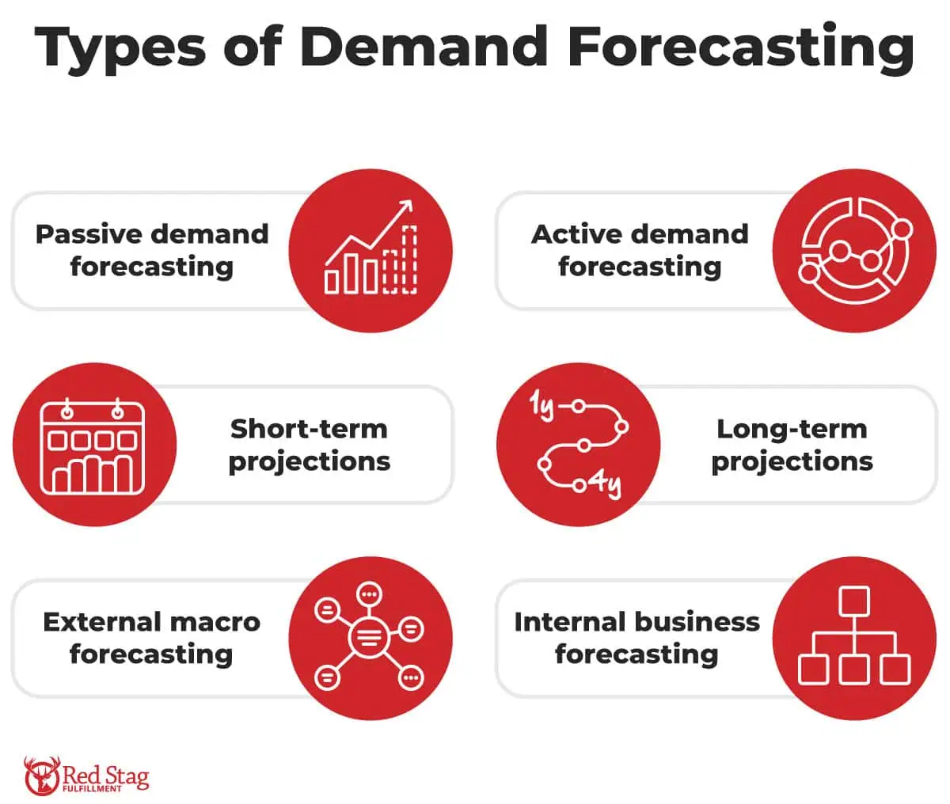
Demand forecasting is the process of estimating future demand for a product or service.

Slide 22
Passive demand forecasting uses sales data from the past to predict future demand.
An active forecasting model takes into consideration your market research, marketing campaigns, and expansion plans.
Short-term demand forecasting only looks at the next three to 12 months.
Your long-term demand forecast will make projections one to four years into the future.

Slide 23
External macro forecasting incorporates trends in the broader economy, examines how those trends affect your goals on a macro-level, and gives you direction on how to meet those goals.
Internal business demand forecasts review your operations to ensure you can meet customer demand and growth goals.

Slide 24
3. Encourage Collaboration Between Partners
Different members of the supply chain need to work together to avoid feeling the bullwhip effect. Shared information plays a large role here, allowing different entities to collaborate and see more of the supply chain than just the level they control. Collaboration is especially important in increasingly globalized supply chains, where products may cross borders and go through many different businesses.
Real-time data and end-to-end visibility are essential. Sending purchase orders, for example, is a far cry from strategic collaboration in which you and your partners work to improve forecast accuracy, strengthen relationships, and prevent disruptions before they occur. Aligning your key performance indicators (KPIs) and other performance measures can help everyone stay on the same page. VMI is foundational for this approach, as it puts the necessary information for working together in one place, and leverages EDI to both push and pull inventory and order data between partners.
Robust collaboration is one of the best defenses against the bullwhip effect, which generally comes from disconnected inventory practices.

Slide 25
4. Reduce Lead Times
Long lead times can exacerbate the bullwhip effect, with products arriving far after they’re needed and becoming overstock. Reducing lead times across the board and placing orders when demand is high can mitigate bullwhip issues.
The factors affecting lead times will vary by the needs of your business, but some strategies to shorten lead times include:
Using trusted, local suppliers: Reducing the distance the product needs to travel can minimize lead times and decrease costs. This option isn’t always viable, but finding reliable, speedy partners is always possible.
Investing in VMI: Instead of waiting for incoming orders, you can use real-time data to jumpstart replenishment and drastically reduce, or sometimes eliminate, the time shelves spend empty.
Hiring a logistics manager: With a team member dedicated to logistics, you can improve the level of oversight and attention given to inventory management. Ideally, they can reduce your lead times and help with other elements of the bullwhip effect.
Reevaluating your shipping methods: If long lead times or inconsistent deliveries are a problem for you, see if you have other shipping options. If one of your partners ships overseas via boat but offers air shipping, see if this option might work for you. Additional costs could be outweighed by the benefits of more predictable inventory.
Automating manufacturing: On the manufacturing side, you may be able to offer faster lead times with automated equipment and software that helps create a more efficient process.

Slide 26
5. Minimize or Address Price Fluctuations
If you frequently run promotions or discounts, you may be disrupting typical buying patterns and have more trouble predicting demand. Evaluate your stance on these promotions and see if they might be causing more interruptions than benefits. You may not need to get rid of them altogether but consider minimizing them or incorporating them more accurately into your predictions and forecasts.

Slide 27
Implementing the Right Technology
The bullwhip effect can quickly get out of control and hit every part of the supply chain with adverse effects. Visibility and transparency are some of your best resources for fighting the bullwhip effect, and the right platforms can help you find both.
Whether you’re a seller, supplier, 3PL, or another member of the supply chain, you can mitigate the bullwhip effect with solutions across the board, including fully managed EDI services, a comprehensive VMI solution, and next-generation supplier management portals. TrueCommerce helps you connect with every entity of the supply chain so you can better avoid the bullwhip effect and keep your inventory consistent. All of this comes with the 24/7 expertise of our support team.

Slide 28
Which of the following is a key benefit of implementing Just-In-Time (JIT) inventory management?
A) Increased inventory carrying costs
B) Reduced lead time and stockouts
C) Higher overhead costs due to excess stock
D) Increased warehouse space utilization

Slide 29
Which of these is the main focus of the "last mile" in supply chain logistics?
A) Managing supplier relationships
B) Transporting products from the distribution center to the final customer
C) Raw material procurement
D) Manufacturing products

Slide 30
What does the term "lead time" refer to in supply chain management?
A) The time taken to manufacture a product
B) The time between when an order is placed and when it is delivered
C) The time suppliers need to restock materials
D) The time taken to process payments for inventory

Slide 31
Which type of inventory model is commonly used in e-commerce to handle fluctuations in customer demand?
A) Economic Order Quantity (EOQ)
B) Just-In-Time (JIT)
C) Safety stock and reorder point models
D) Continuous review model

Slide 32
What role does technology play in modern e-commerce supply chain management?
A) Reducing the need for suppliers
B) Increasing the complexity of operations
C) Automating processes such as demand forecasting, inventory management, and order fulfillment
D) Eliminating customer satisfaction issues

Slide 33
Which of the following is a disadvantage of outsourcing e-commerce supply chain functions to third-party logistics providers (3PLs)?
A) Increased control over the supply chain
B) Reduced shipping costs
C) Lack of direct control over the logistics process and potential quality concerns
D) Improved scalability and flexibility

Slide 34
What does "demand forecasting" involve in e-commerce supply chains?
A) Estimating future sales to determine the amount of inventory needed
B) Planning marketing campaigns for the upcoming season
C) Identifying suppliers for new product lines
D) Determining how much labor is required in the warehouse

Slide 35
True/False Questions
E-commerce supply chains are primarily concerned with the physical flow of goods and the digital flow of information.
True
False

Slide 36
Key points about the significance of last mile delivery in e-commerce:
Customer Satisfaction:
Competitive Advantage:
Sales and Revenue Growth:
Brand Reputation:
Cost Considerations:

Slide 37
Outsourcing" in supply chain management refers to using internal resources for inventory and fulfillment operations
True
False

Slide 38
A key difference between traditional retail supply chains and e-commerce supply chains is the importance of last-mile delivery in e-commerce.
True
False

Slide 39
Supply chain visibility means being able to track and manage all aspects of the supply chain in real time.
True
False

Slide 40
The role of "supply chain resilience" is to ensure that a supply chain can quickly recover from disruptions and continue operating smoothly.
True
False

Slide 41
Explain the concept of "supply chain integration" and how it is important in e-commerce logistics.
Answer: Supply chain integration refers to the alignment and coordination of all parts of the supply chain—from suppliers to manufacturers to distributors to retailers. In e-commerce, this integration is vital for streamlining operations, improving communication, and ensuring timely deliveries, especially with the need to synchronize inventory management, order processing, and last-mile delivery.

Slide 42
What are the key challenges e-commerce companies face in managing inventory, and how can technology help address these challenges?
Answer: Key challenges include demand forecasting inaccuracies, stockouts, and overstocking. Technology, such as AI and machine learning, can improve demand forecasting accuracy, automate inventory tracking, and ensure real-time data updates to optimize stock levels, reduce excess inventory, and minimize disruptions in the supply chain.

Slide 43
Describe the concept of "omnichannel fulfillment" in the context of e-commerce supply chains. How does it impact customer satisfaction?
Answer: Omnichannel fulfillment involves fulfilling orders from multiple channels (e.g., online, physical stores, mobile apps) in a seamless and integrated manner. It impacts customer satisfaction by providing flexible delivery options such as click-and-collect, ship-from-store, and home delivery, enhancing convenience, and reducing delivery times.

Slide 44
How does a "Vendor Managed Inventory" (VMI) system work, and what advantages does it offer in the e-commerce supply chain?
Answer: A VMI system allows suppliers to monitor and manage inventory levels at the retailer’s warehouse or distribution center. The supplier is responsible for replenishing inventory based on predefined thresholds. This reduces the risk of stockouts, minimizes excess inventory, and streamlines the ordering process for both parties.

Slide 45
What is "supply chain visibility," and why is it critical for e-commerce businesses?
Answer: Supply chain visibility refers to the ability to track the movement and status of goods and orders in real time across the entire supply chain. In e-commerce, it is critical for improving decision-making, managing customer expectations, optimizing delivery routes, and providing accurate updates to customers regarding their orders.

